Slide 1



Building a Serverless
Data Lake on S3
Yannis Oikonomidis

Slide 2



About me
> 10 Years of experience
~2 Years at Orfium
Software Engineer
1,5 Years on AWS

Slide 3
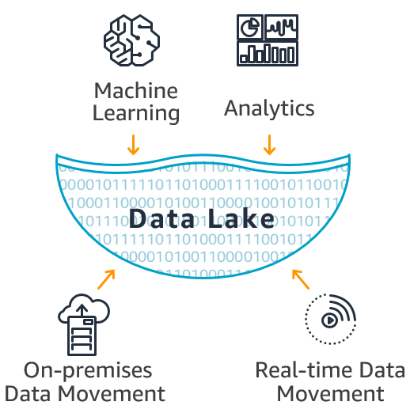


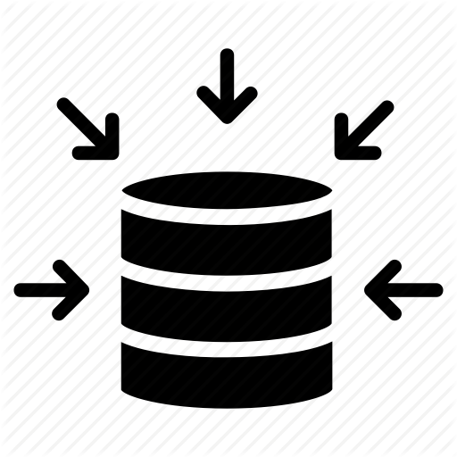

Data Lakes
All data in one place
Easy access
Combine different formats
Quick insertion of data
Notes:
Data lakes are rapidly increasing on popularity and more and more companies are starting to use them and for good reasons for machine learning, analytics, and storage.

Slide 4
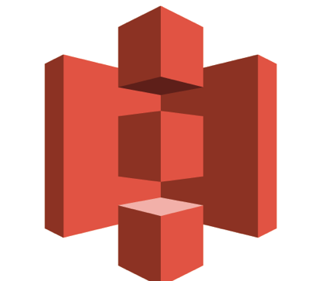


Building a Data Lake on AWS
Amazon S3
Amazon Glue
Amazon Athena

Slide 5



Amazon Glue - Schema Discover/Crawlers
Discover new Data
Extract schema definitions
Detect schema changes
Detect Hive style partitions
Run ad hoc
Run scheduled

Slide 6




Amazon Athena - Overview
Serverless
High Availability
Easy to Use
5$ / TB of scan

Slide 7
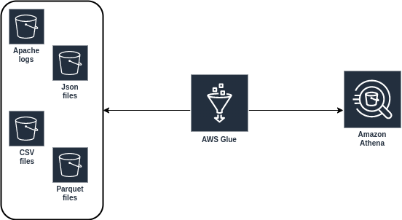
Simple Serverless Data Lake
Schema Extraction
“Database”
Multiple files
Different formats

Slide 8
Demo Time

Slide 9

Athena Pros
Very Cheap
5$ / TB of scan
Serverless
Easy to setup
Big data
Low latency
Federated (beta)

Slide 10


Athena Cons
No update/delete
Very slow if not
used properly

Slide 11

Best Practices
Apache Parquet
Split into smaller parts >200MB/part
Streamable compression i.e. SNAPPY
Use partitions and optimize costs
Use Glue to map your schema

Slide 12
Thank you

Slide 13


Amazon Athena - Under The Hood
Apache Hive is a data warehouse software project built on top of Apache Hadoop for providing data query and analysis
Amazon Athena uses Hive only for DDL (Data Definition Language) and for creation/modification and deletion of tables and/or partitions.
Open source distributed SQL query engine for running interactive analytic queries against data sources of all sizes (GBs to PBs)

Slide 14
References
https://aws.amazon.com/blogs/big-data/top-10-performance-tuning-tips-for-amazon-athena/

